Slide 1

Members: Syed - 301318212 Joemar - 301355179 Mark - 301346652 Tarun - 301464055
Brute Force Attack:
Detection and Response using Machine Learning

Slide 2

Introduction
Brute force attacks, a leading method, are increasingly difficult to detect due to the prevalence of high-speed networks and rising encryption of traffic. In these attacks, applications systematically try all possible character combinations to find the correct input, making longer passwords more resilient.
Attackers commonly use vast password dictionaries for testing. Successful brute force attacks grant access to data, applications, and resources, potentially leading to further breaches.

Slide 3
Propose and Approach
Proposed Deep Learning Classifier for Brute force attack detection
The study utilized the design science research methodology and proposed a method consisting of feature selection and a deep learning algorithm.
The deep learning algorithm is responsible for developing intelligence or knowledge based on the outcomes of feature selection, utilizing a dataset.

Slide 4
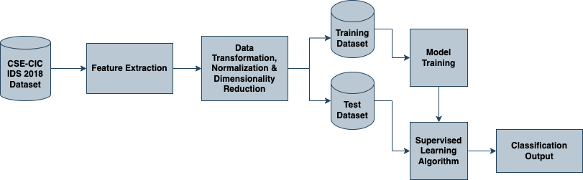
Propose and Approach
Proposed Deep Learning Classifier for Brute force attack detection

Slide 5
Dataset
The study utilized the CIC-IDS 2018 benchmark dataset, which comprises real-time network traffic data encompassing both benign and malicious activities. The benign traffic, collected using a B-profile system, represents the behaviors of 25 users across various protocols such as HTTP, HTTPS, FTP, SSH, and email.
The dataset spans five days, with normal activity observed on one day and injected attacks on the other days, including Brute Force FTP, Brute Force SSH, Denial of Service, Heartbleed, Web Attack, Infiltration, Botnet, and Distributed Denial of Service.
The dataset was generated using CICFlowMeter-V3 and contains 83 features, including both forward and backward directions of network flow and packets.

Slide 6
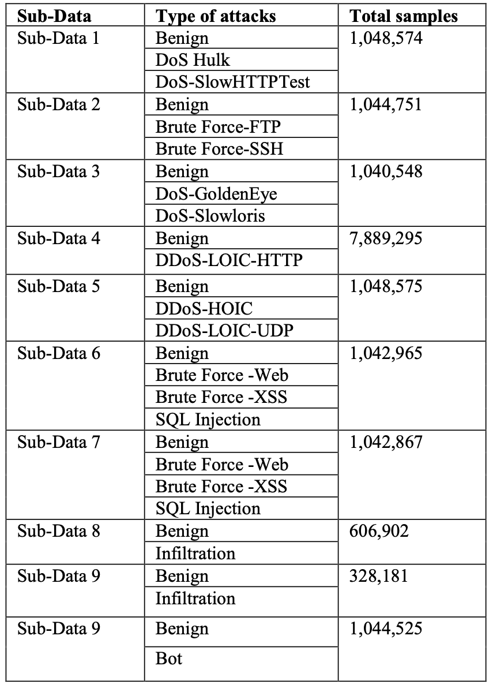
Dataset

Slide 7

Screenshots from Kali Linux

Slide 8
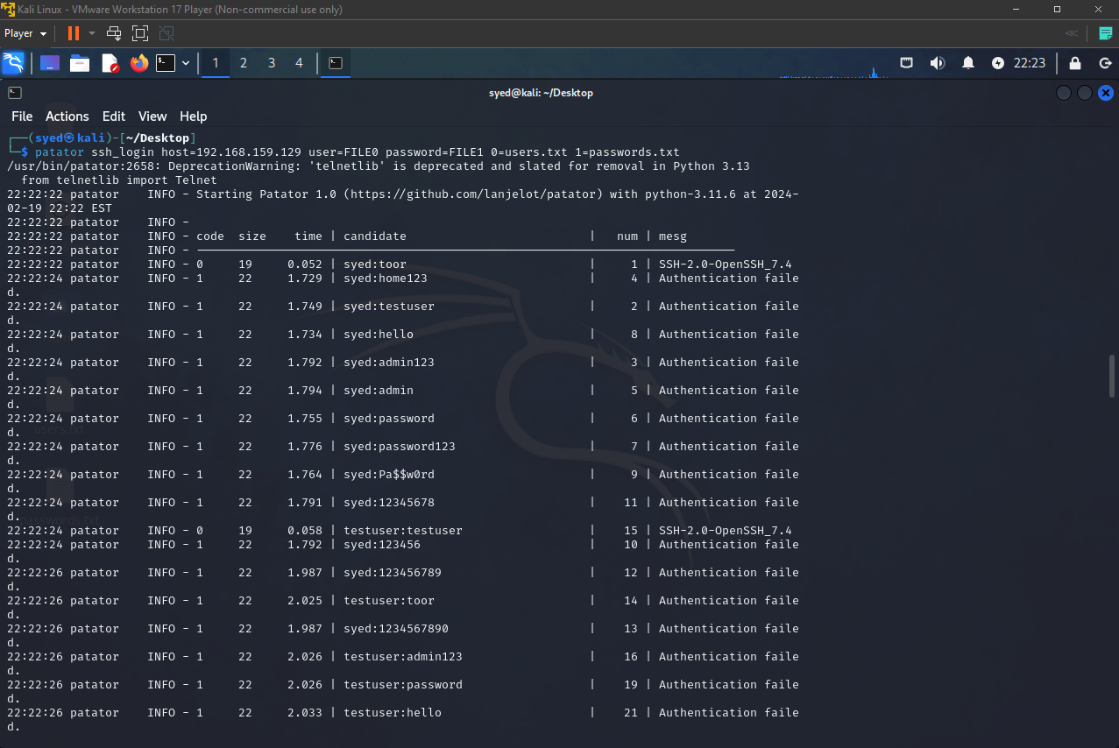
SSH Brute Force

Slide 9
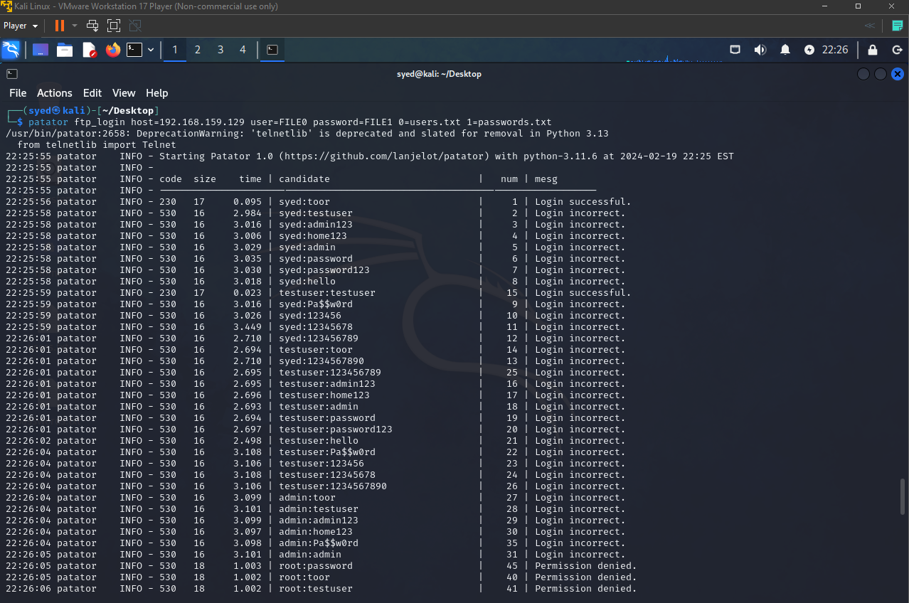
FTP Brute Force

Slide 10
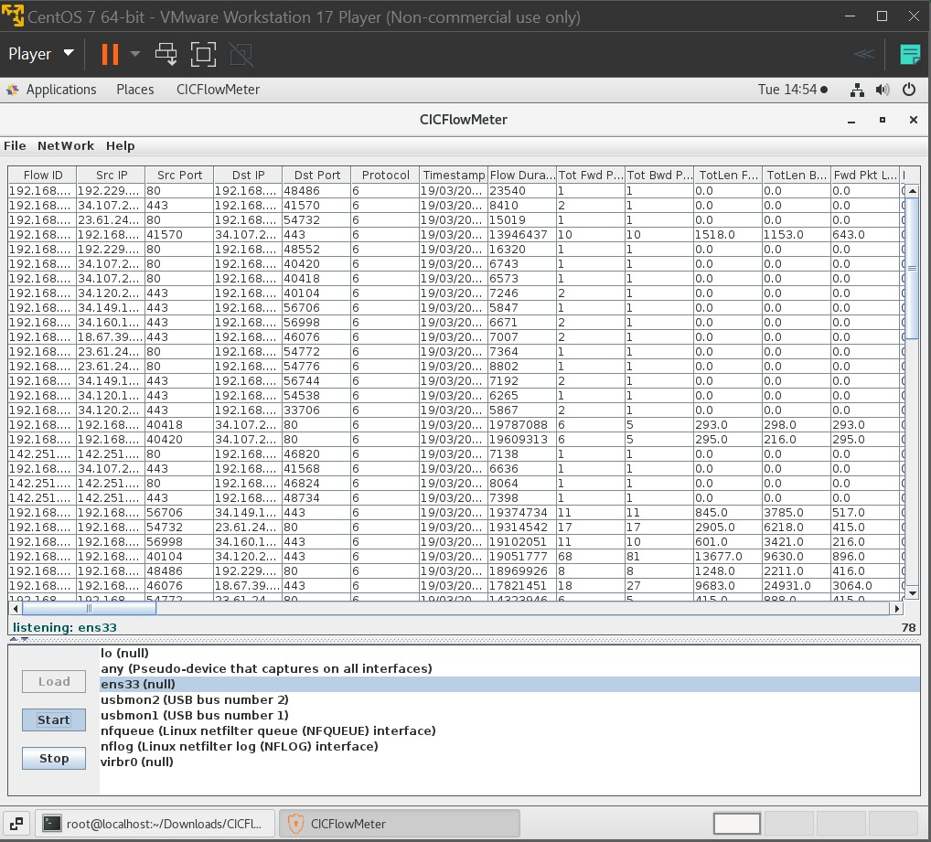
CIC Flow Meter Tool – capturing the data

Slide 11

Python Output Screenshots

Slide 12



CSE-CIC IDS 2018 dataset
Custom
Generated Dataset
Data Preprocessing
Handling missing values
Dropping duplicate rows
Dropping categorical columns
Dropping null values and zero columns
Feature scaling
Normalization
Label encoding
Feature Selection using Random Forest
ML Models
Decision Trees
Random Forest
MLP
KNN
Naïve Bayes
Train models
Test models
Performance Analysis

Slide 13

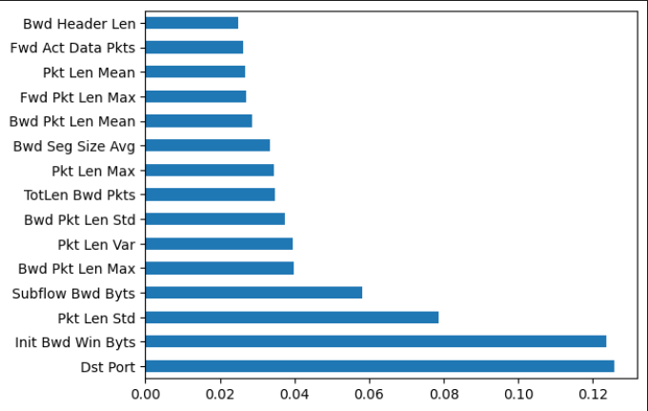
Important Features Extracted

Slide 14
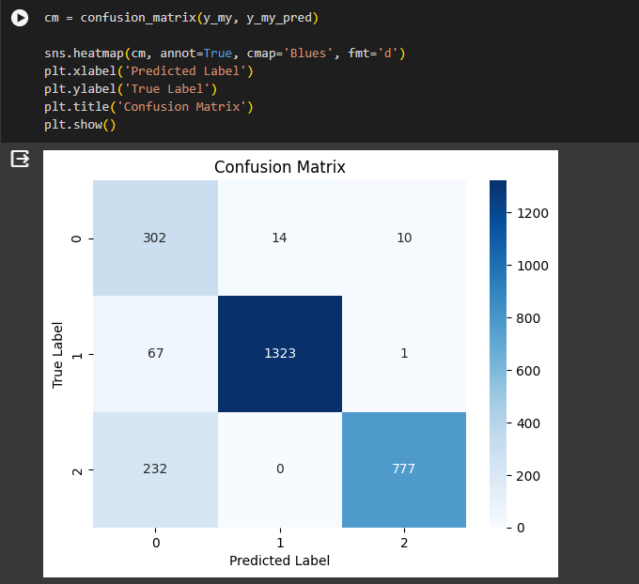
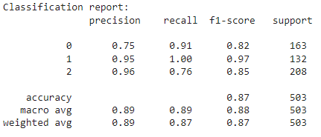
Decision Tree (Trained using online dataset)

Slide 15
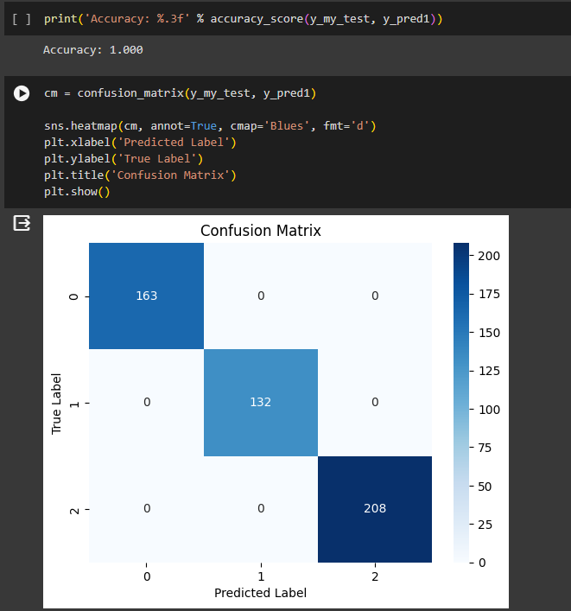
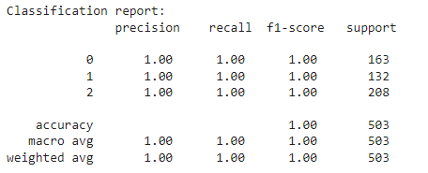
Decision tree (Trained using our dataset)

Slide 16
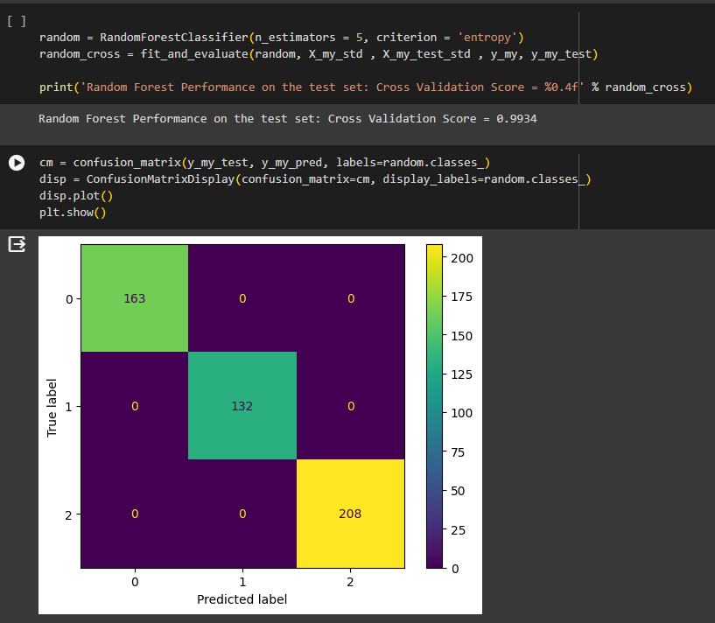
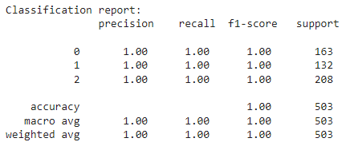
Random Forest (Trained using our dataset)

Slide 17
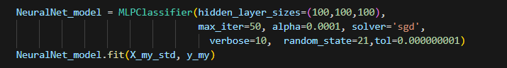
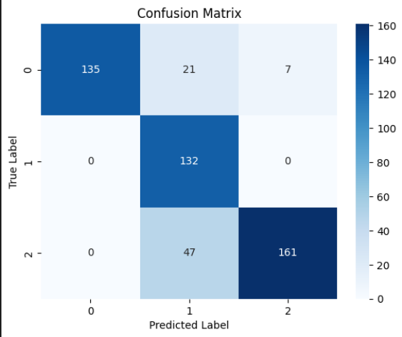
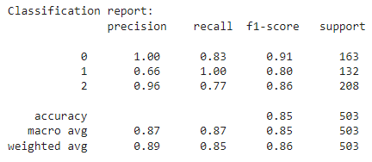
MLP (Trained using our dataset)

Slide 18
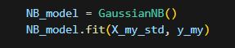
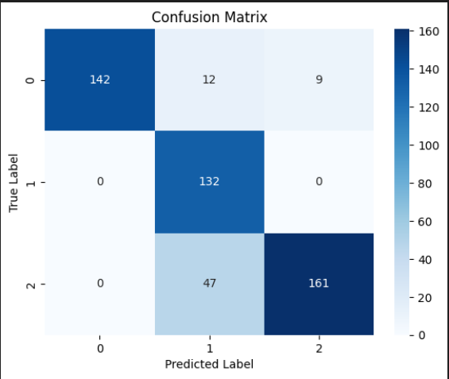
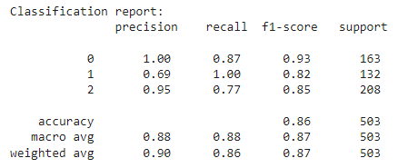
Naïve Bayes (Trained using our dataset)

Slide 19
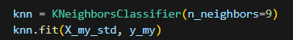
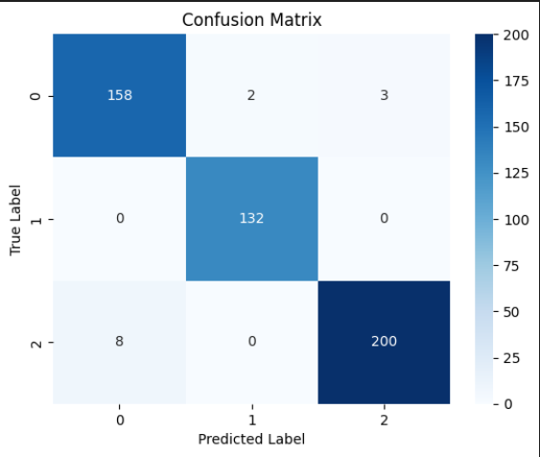
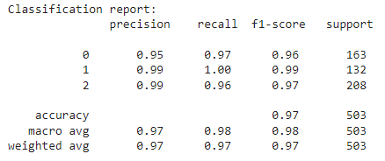
KNN (Trained using our dataset)

Slide 20
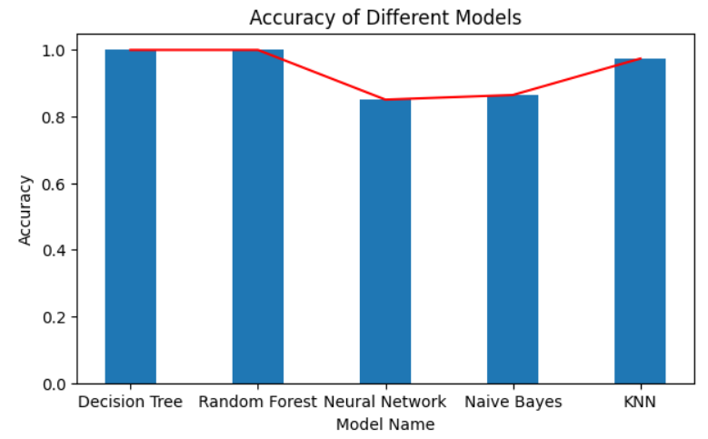
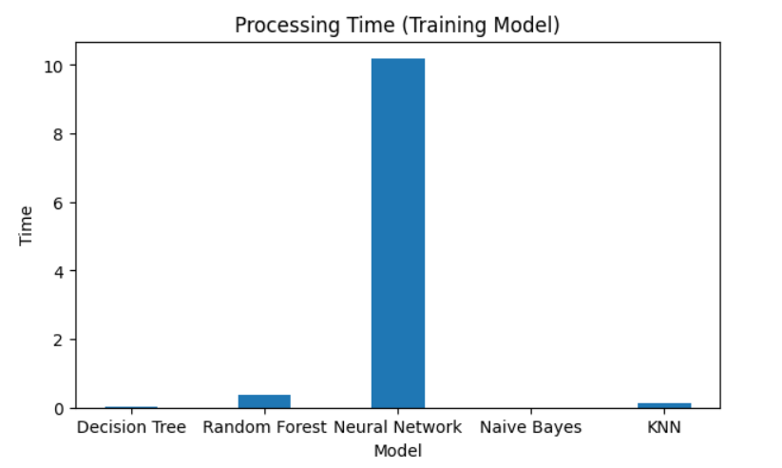
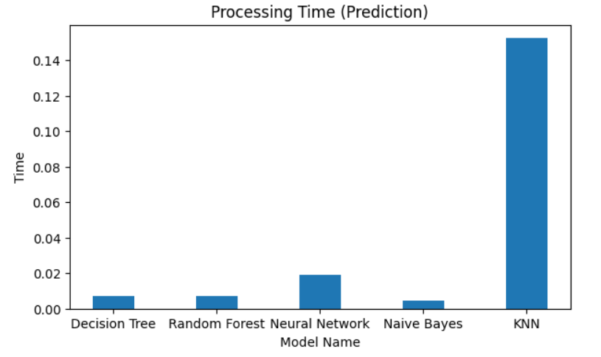
Performance Analysis

Slide 21
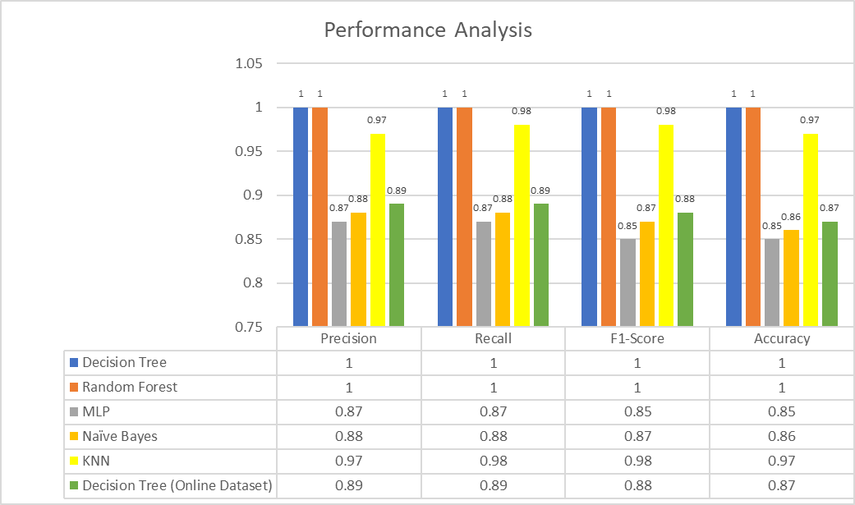
Performance Analysis

Slide 22
Next Milestone
Comparing different algorithms for efficiency

